Slide 1
A PointNet++ Based Model for 3D Object Classification
LIN Di, Qu Zhiyan

Slide 2
01
Introduction
Content
02
Preprocessing
03
Model Performance
04
Evaluation

Slide 3
01
Introduction

Slide 4
1. Introduction
Selected Task
Our project is about 3D Object Classification, try to use different deep learning algorithm (such as PointNet, PointNet++) on point clouds for 3D Object Classifiction to get best performance.
Source paper of Algorithm:
[1] PointNet: Deep Learning on Point Sets for 3D Classification and Segmentation
[2] PointNet++: Deep Hierarchical Feature Learning on Point Sets in a Metric Space

Slide 5
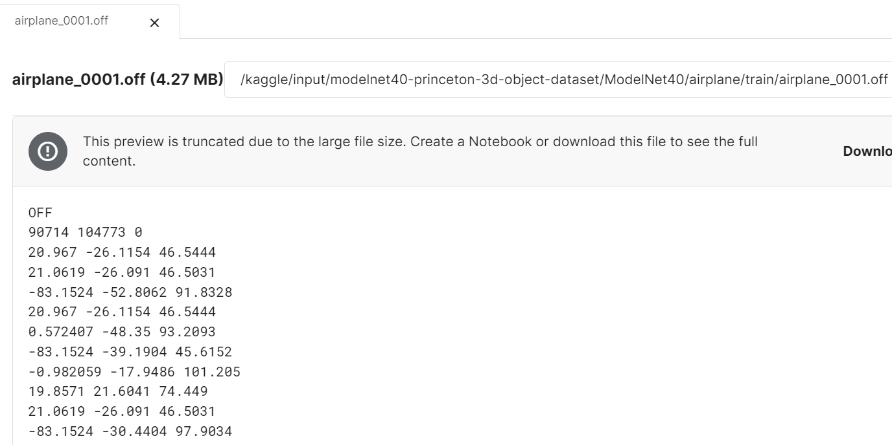
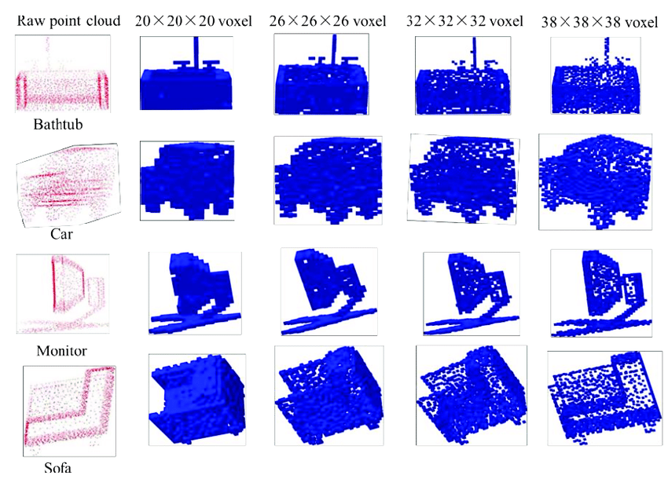
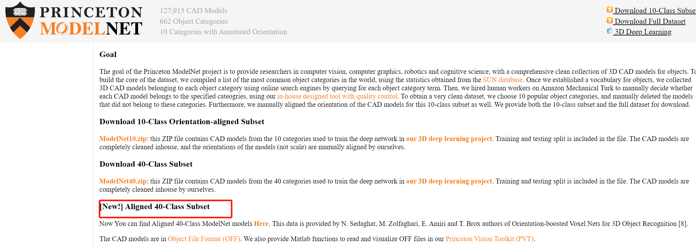
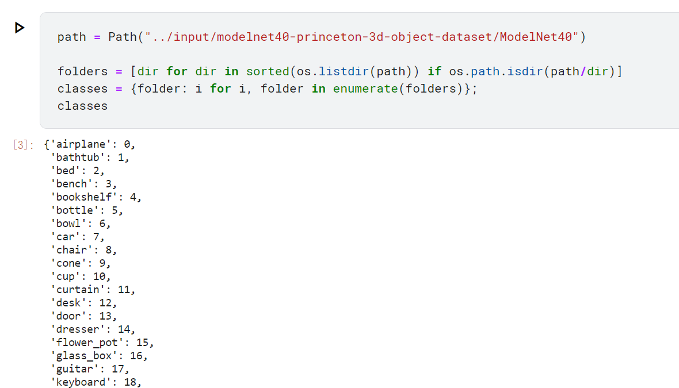
1. Introduction
Dataset——ModelNet40 - Princeton 3D Object Dataset
ModelNet40 dataset contains 12,311 pre-aligned shapes from 40 categories, which are split into 9,843 (80%) for training and 2,468 (20%) for testing. The CAD models are in Object File Format (OFF). Matlab functions to read and visualize OFF files are provided in Princeton Vision Toolkit (PVT).
Link: https://modelnet.cs.princeton.edu/#

Slide 6
02
Preprocessing

Slide 7
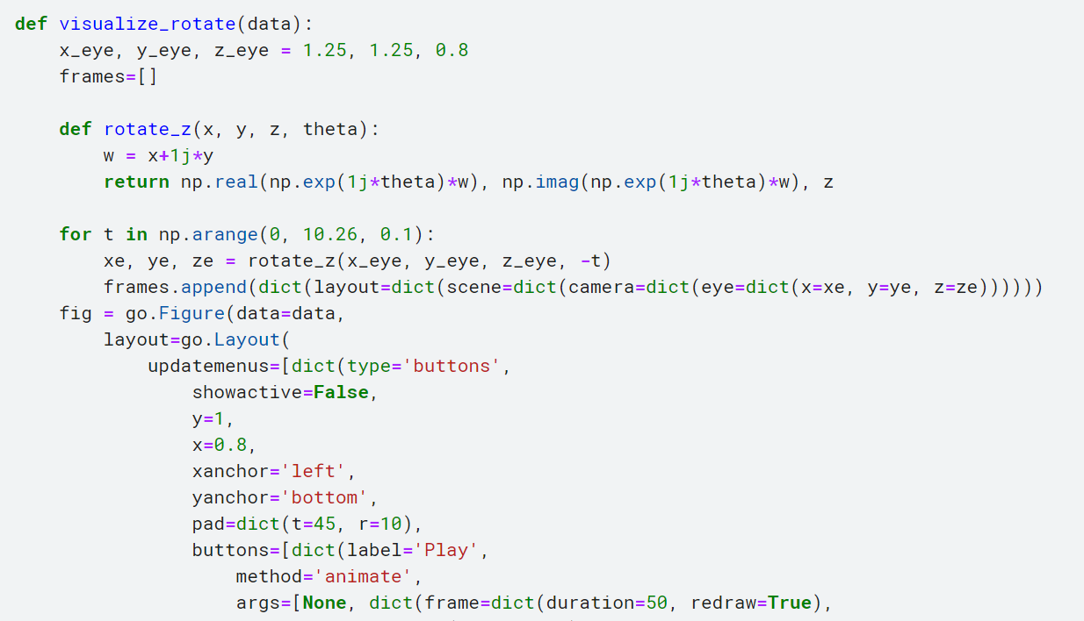
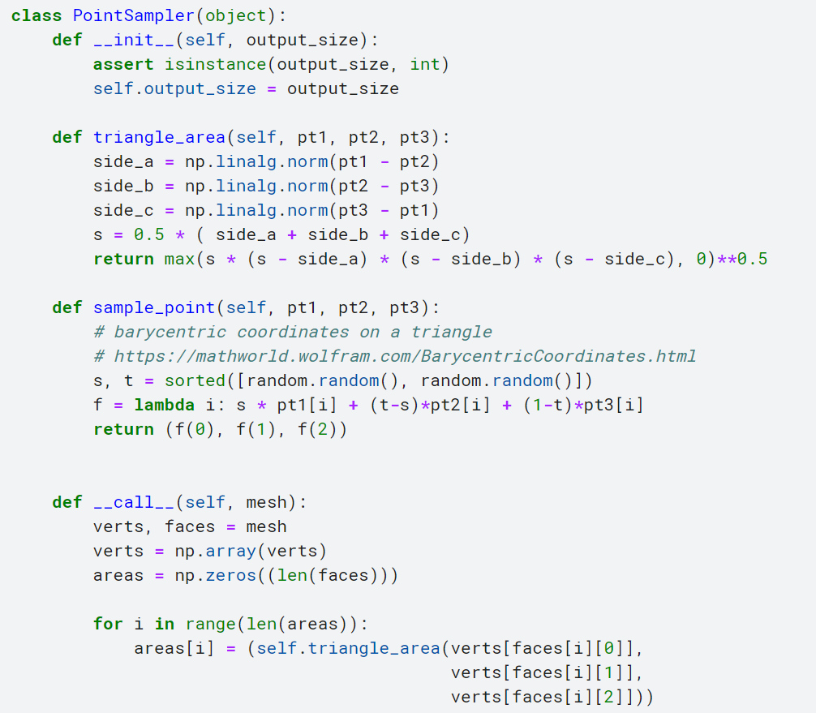
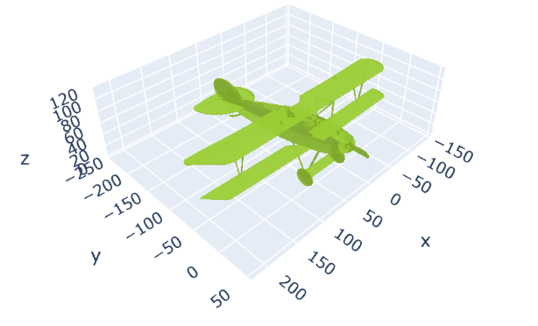
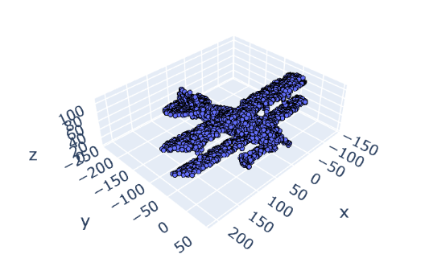
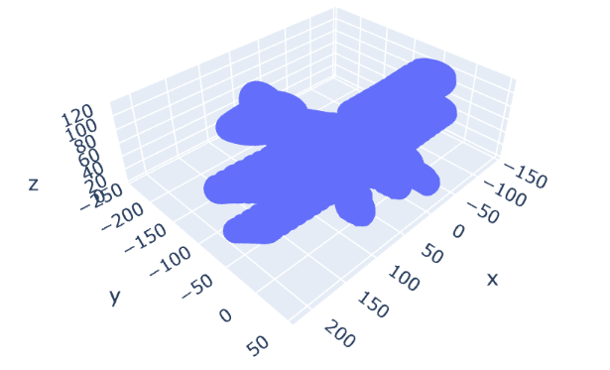
2.Preprocessing
2.1 Visualization and sampling
Load one 3D project (airplane_0001.off) as the example, visualizing data with rotation, sampling (3000 points for each project.)

Slide 8
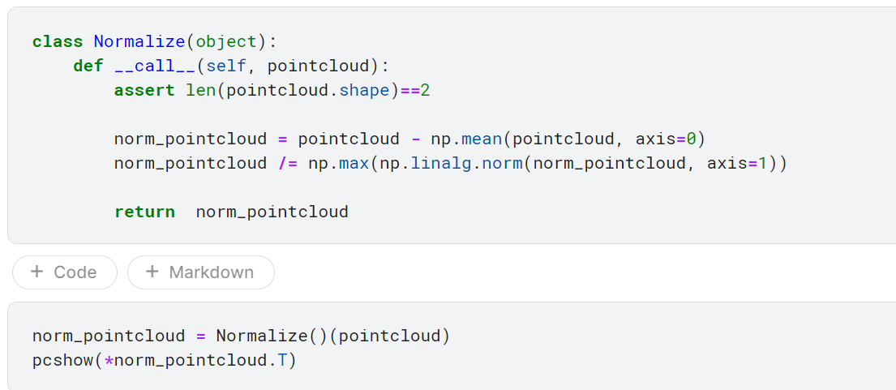
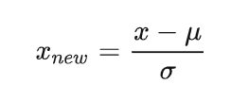
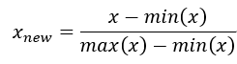
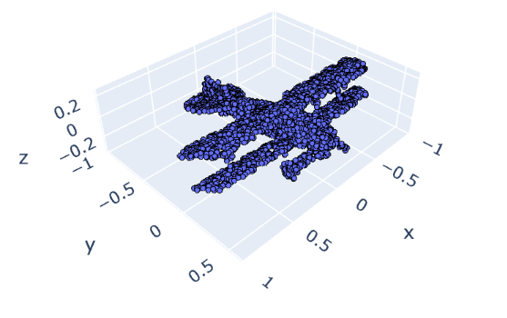
2.Preprocessing
2.2 Normalization
Standard:
Min-Max Normalization:
Notes:
In order to more intuitively compare the effects of different dimensionality reduction methods, we selected 10 graphs and reconstructed them after dimensionality reduction.
The above figures are the comparison of PCA and NMF respectively. We can obviously see that gestures and backgrounds can still be distinguished in PCA images after reconstruction.
The image of the NMF has become difficult to distinguish.
The following comparison with the original image illustrates this point.

Slide 9
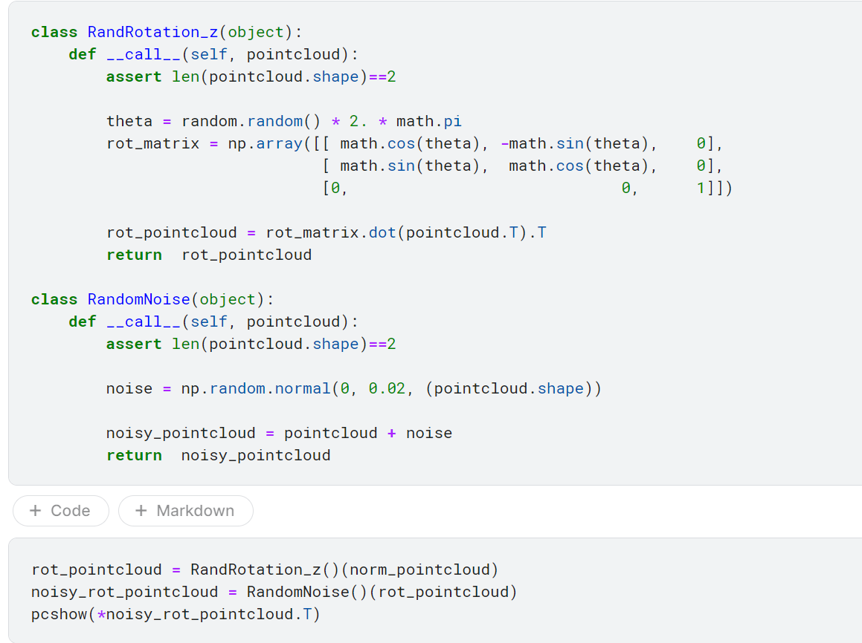
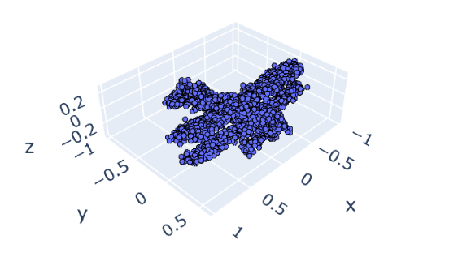
2.Preprocessing
2.3 Data Augmentation
To enlarge dataset for PointNet, we need do some data augmentation, such as random rotation and adding random noise.
Notes:
The following left figure is the cumulative contribution rate graph. From this figure, we can see the for the first 100 features, each addition of a feature can increase a large contribution rate. With the increase of dimension, the increase of contribution rate gradually slows down or even flattens out.
The following right figure shows the classification results on the same model after using PCA to retain different numbers of features.
As we can see we chose to retrain [4,8,10,20,40,50,80,100,150,200,300,500] 12 kinds of non-arithmetic features for model training. The result reached the maximum accuracy with 50 components.
We also used NMF to reduce dimensions. However, the results of NMF are not as good as those of PCA. The dimension reduction way of PCA can achieve higher accuracy of the model. Therefore, PCA was used for dimension reduction

Slide 10
03
Model Performance

Slide 11
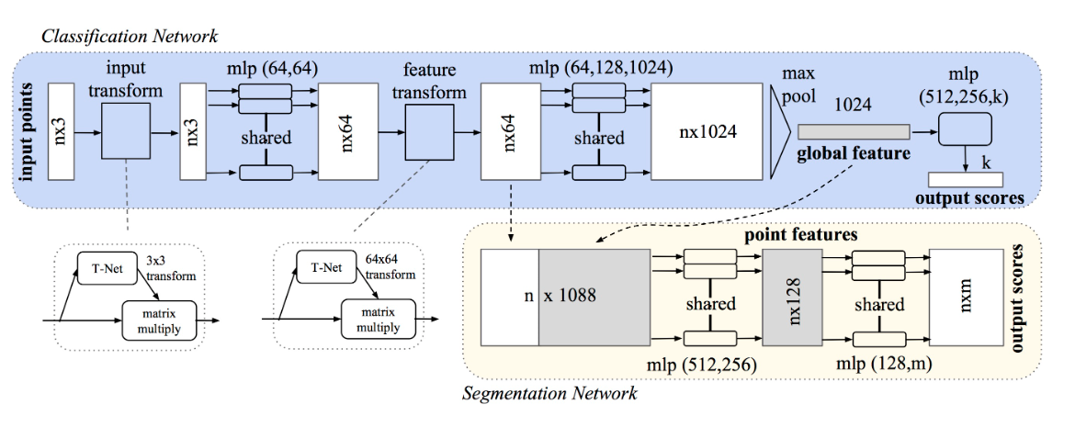
3.1 PointNet Model Architecture
(1) The classification network takes n points as input, applies input and feature transformations, and then
aggregates point features by max pooling.
(2) The output is classification scores for k classes.
(3) The segmentation network is an extension to the classification net. It concatenates global and local features and outputs per point scores.
(4) “mlp” stands for multi-layer perceptron, numbers in bracket are layer sizes.
(5) Batchnorm is used for all layers with ReLU.
(6) Dropout layers are used for the last mlp in classification net.

Slide 12
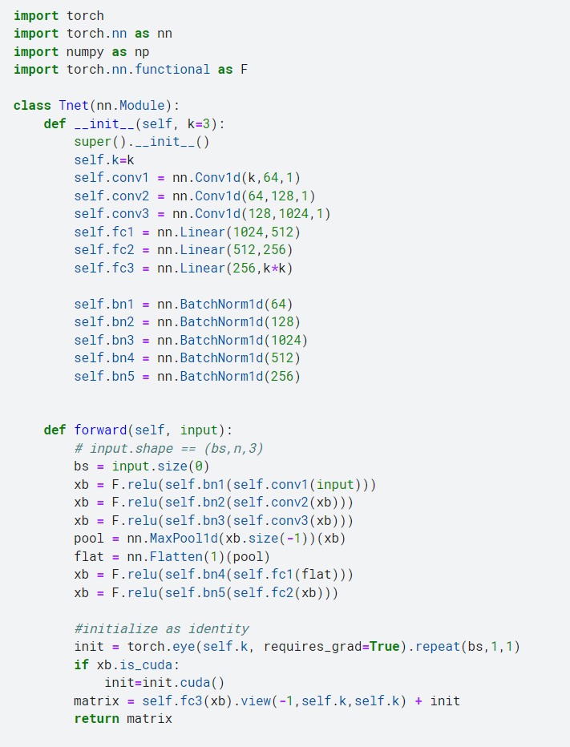
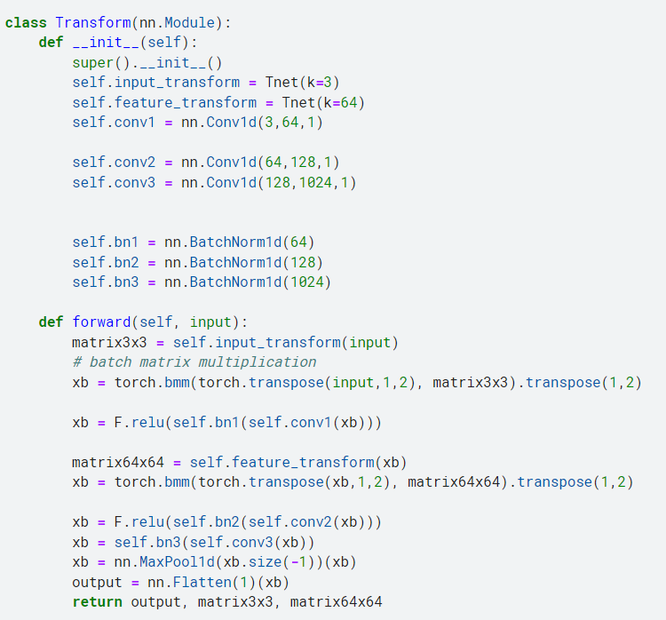
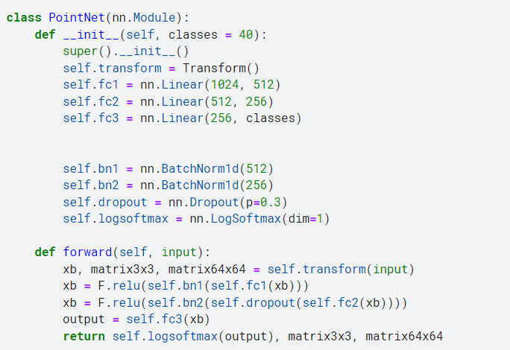
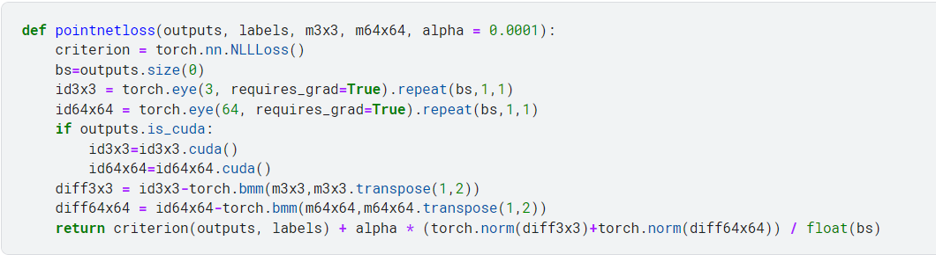
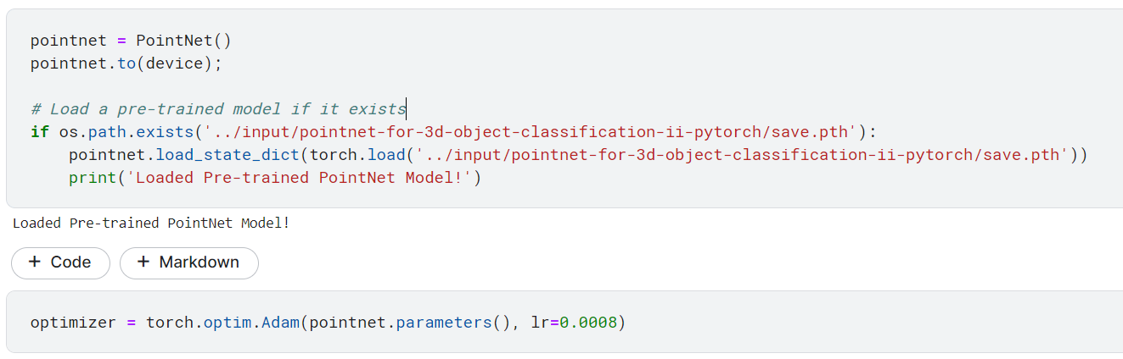
3.2 Build the PointNet Model (PyTorch)

Slide 13
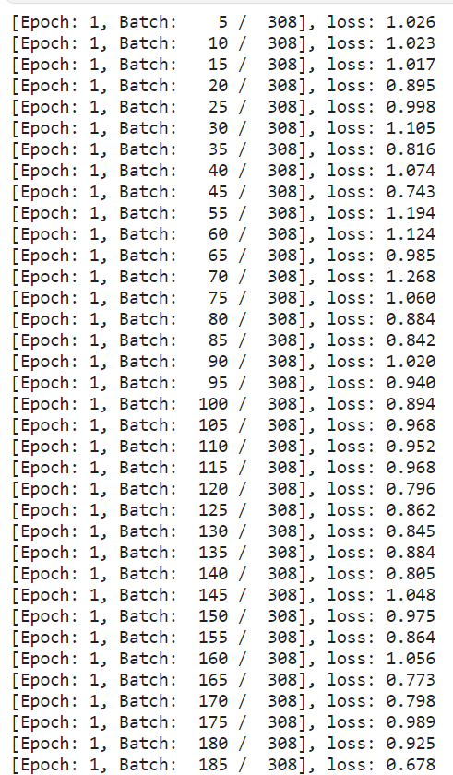
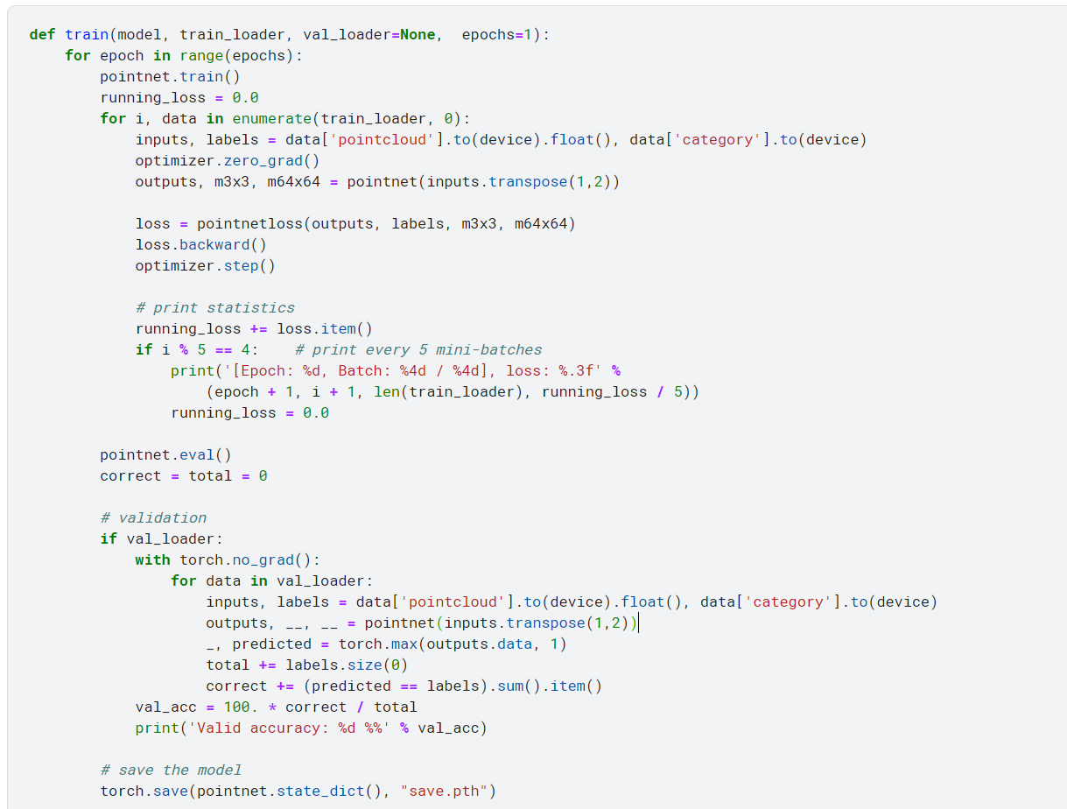
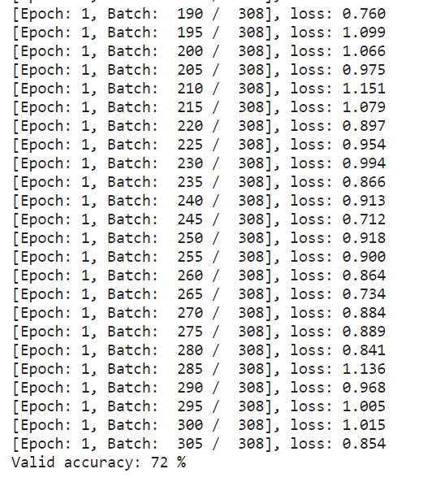
3.3 Train the PointNet Model
Valid accuracy: 72% (epoch = 1)

Slide 14
04
Evaluation

Slide 15
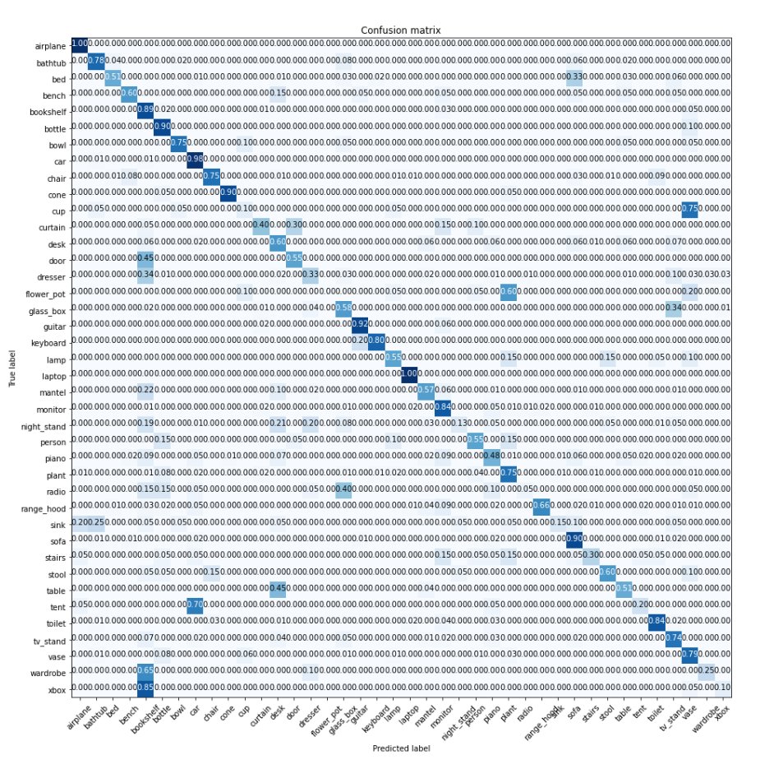
Confusion Matrix

Slide 16
Drawback of PointNet
Calculating per pixel features, then a single round of global pooling. Loses a lot of information.
Point clouds don't have the same info (ordering, adjacency), but they do have distances which define local neighborhoods that aren't being used here.

Slide 17
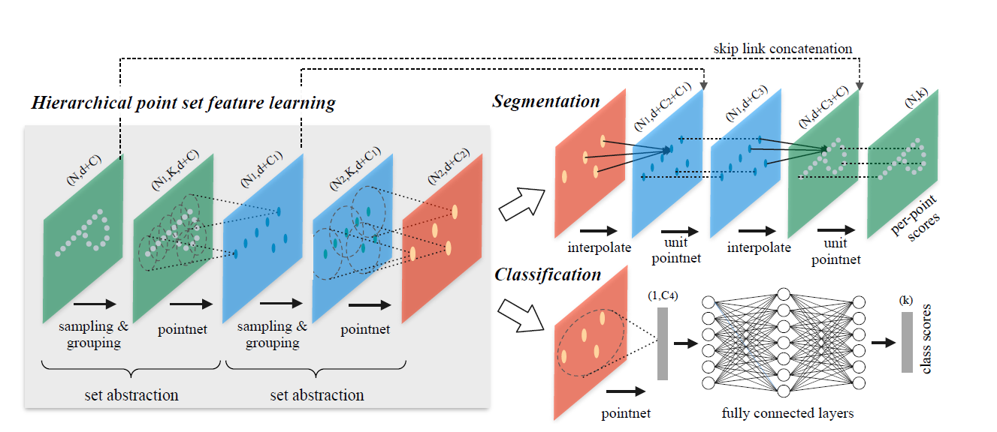
PointNet++
PointNet++ adds a set abstraction structure on the basis of PointNet, which is used to extract the neighborhood information of points. When segmenting, it first uses the method of distance weighted weight to restore its point cloud by upsampling, and above Point clouds of one resolution are spliced and repeated continuously to achieve an original segmentation scenario.
For the grouping design of the collection abstraction layer, the paper mainly embodies two methods, MSG and MRG, which greatly improve the accuracy rate, and the design is relatively simple.

Slide 18
Thanks for your attention!

